Slide 1
COMP 1010 Final Exam Practice
Dr. Celine Latulipe

Slide 2
sample short answer questions & answers
Notes:
Midterm: basics, active, if, strings (**see midterm sample Q for these topics**)
Final: loops, functions, arrays, PFAs+searching

Slide 3
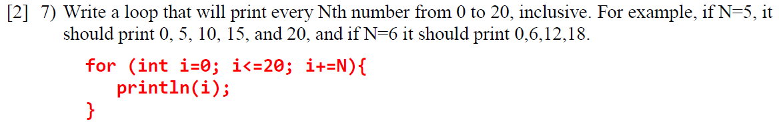
Short Answer Q1

Slide 4
Short Answer Q1

Slide 5
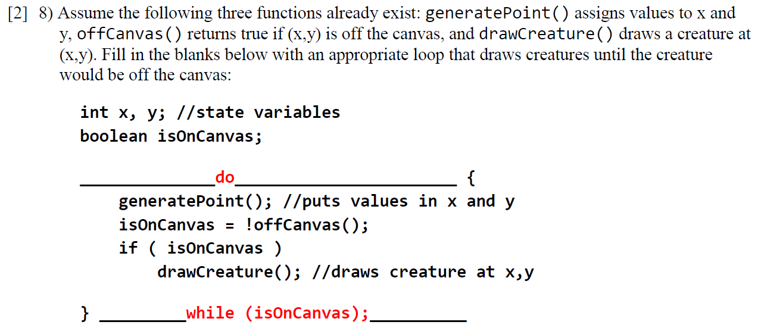
Short Answer Q2

Slide 6
Short Answer Q2

Slide 7
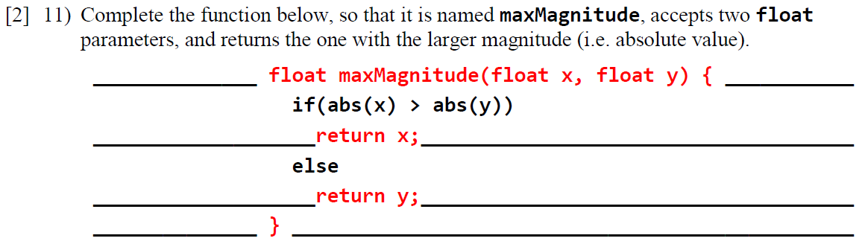
Short Answer Q3
Notes:
Functions

Slide 8
Short Answer Q3

Slide 9
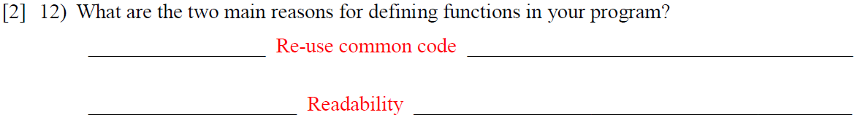
Short Answer Q4

Slide 10
Short Answer Q4

Slide 11
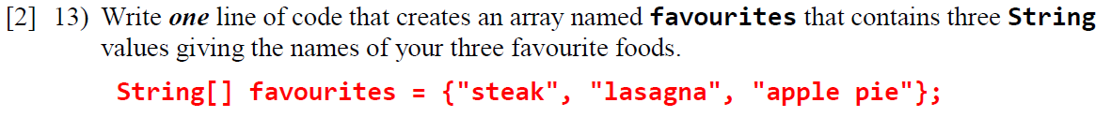
Short Answer Q5
Notes:
Arrays

Slide 12
Short Answer Q5
String[] favourites = { “dal”, “roti”, “chicken curry”};

Slide 13
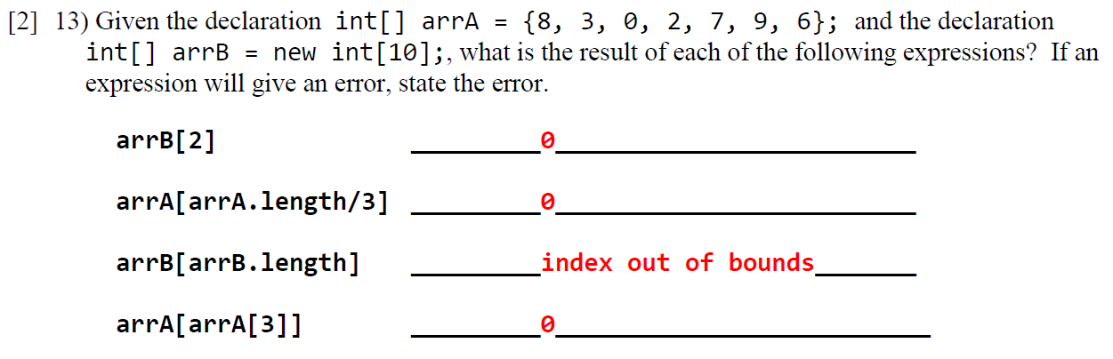
Short Answer Q6
Notes:
Arrays

Slide 14
Short Answer Q6

Slide 15
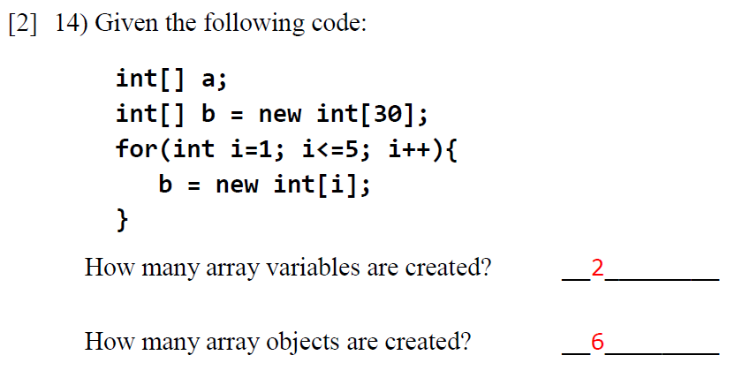
Short Answer Q7
Notes:
Arrays

Slide 16
Short Answer Q7

Slide 17
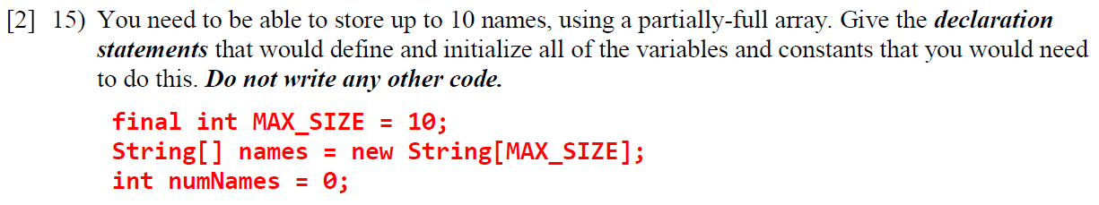
Short Answer Q8
Notes:
PFA

Slide 18
Short Answer Q8

Slide 19
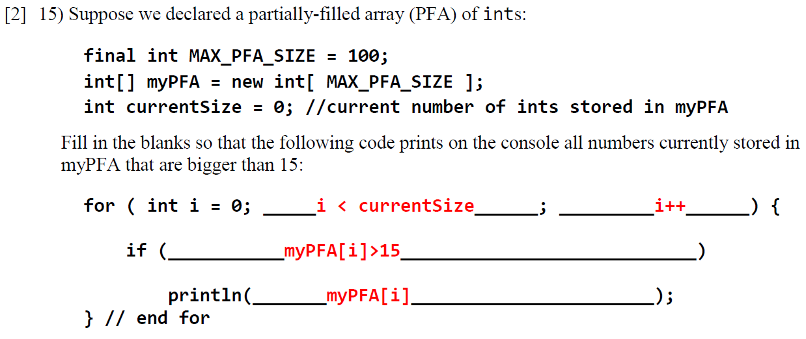
Short Answer Q9
Notes:
PFA

Slide 20
Short Answer Q9

Slide 21
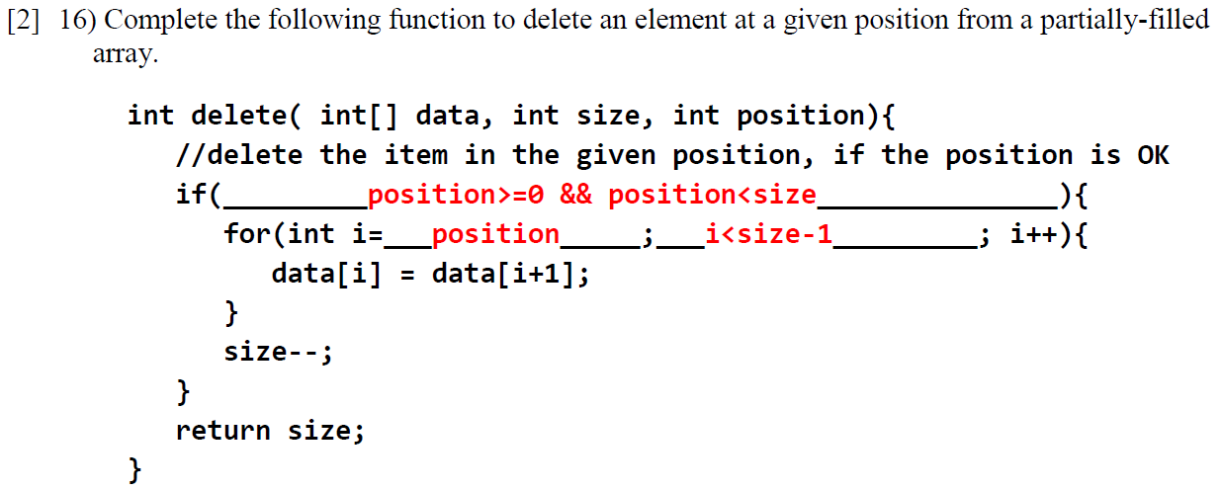
Short Answer Q10
Notes:
PFA

Slide 22
Short Answer Q10

Slide 23
Sample Programming Questions

Slide 24
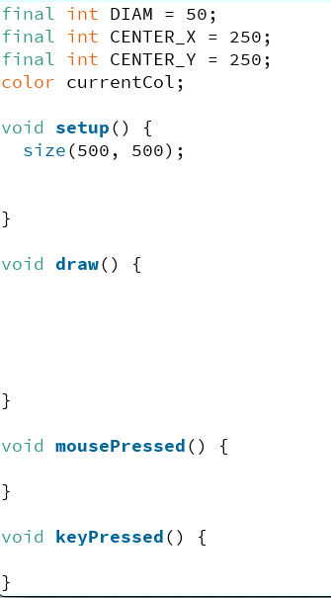
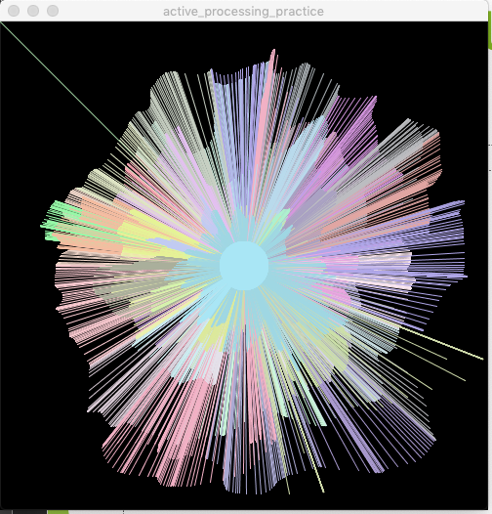
Active Processing Programming Question
Without using any loops or if statements, complete the following program, which continuously draws lines from the center of the canvas to the current mouse cursor position. A random colour should be chosen when the program starts. When the user clicks the mouse, a new random colour is chosen for subsequent line drawing. There is also always a circle in the center of the canvas, showing the current line colour. If the user hits any key on the keyboard, the canvas is cleared back to black.
Pick random colours that are only light, for best contrast against the black background.
Use the provided global variable/constants.

Slide 25
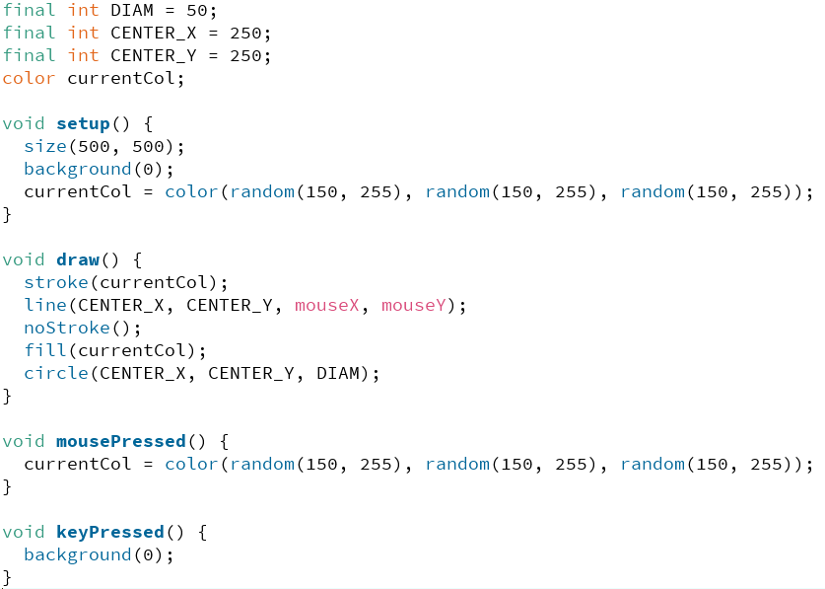
Active Processing Programming Question
Without using any loops or if statements, complete the following program, which continuously draws lines from the center of the canvas to the current mouse cursor position. A random colour should be chosen when the program starts. When the user clicks the mouse, a new random colour is chosen for subsequent line drawing. There is also always a circle in the center of the canvas, showing the current line colour. If the user hits any key on the keyboard, the canvas is cleared back to black.
Pick random colours that are only light, for best contrast against the black background.
Use the provided global variable/constants.

Slide 26
Active Processing Programming Question
Rubric:
0.5 for background(0) in setup for correct
0.5 for initializing currentCol in setup()
0.5 for setting stroke to currentCol before drawing line
1.0 for drawing line from center to mouse
0.5 for noStroke() and fill(currentCol) before circle command
1.0 for correct circle command
0.5 for getting new colour in mousePressed
0.5 for resetting background in keyPressed
MATTHEW
Deductions:
-0.5 for not using provided constants
-1 for unnecessarily adding loops of any kind
-1 for unnecessarily adding if statements/booleans

Slide 27
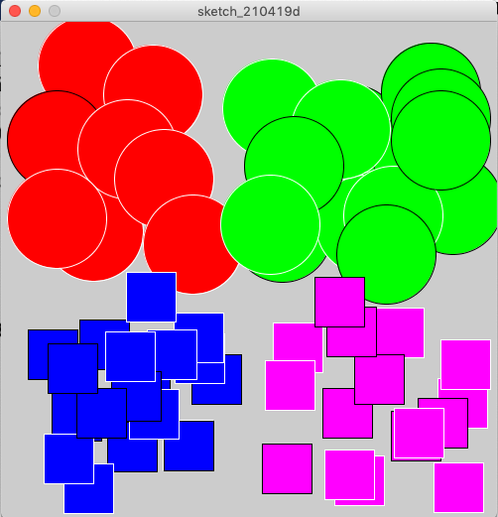

Boolean & IF Programming Question
Write a function called drawShape that takes in two int coordinates (where the shape needs to be drawn), and a boolean. This function should draw a circle if the coordinates are in the top half of the canvas, and a square if the coordinates are in the bottom half of the canvas. The fill color should be set by quadrant:
Top-left: red
Top-right: green
Bottom-left: blue
Bottom-right: purple
Regardless of where the shape is drawn, the outline should be black if the passed in boolean is true, and should be white otherwise. Assume the following two global constants have already been declared:

Slide 28
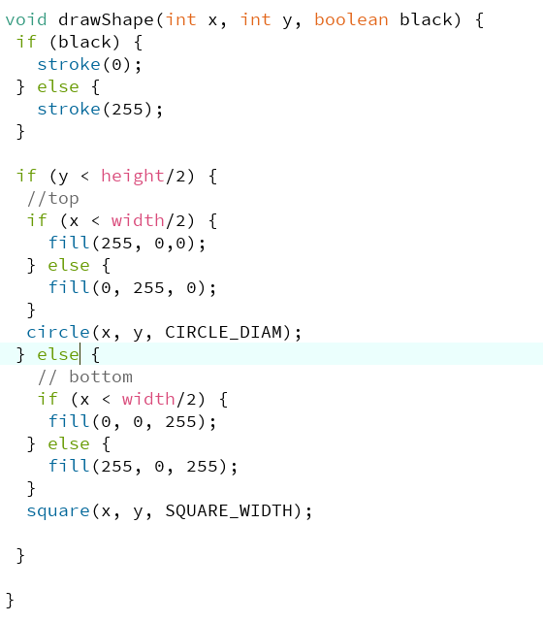
Boolean & IF Programming Question
Write a function called drawShape that takes in two int coordinates (where the shape needs to be drawn), and a boolean. This function should draw a circle if the coordinates are in the top half of the canvas, and a square if the coordinates are in the bottom half of the canvas. The fill color should be set by quadrant:
Top-left: red
Top-right: green
Bottom-left: blue
Bottom-right: purple
Regardless of where the shape is drawn, the outline should be black if the passed in boolean is true, and should be white otherwise. Assume the following two global constants have already been declared:

Slide 29
Boolean & IF Programming Question
Rubric:
1.0 for correct return (void) and parameter types
1.0 for if statement that checks boolean and sets outline colour correctly
1.0 for main if statement that checks top/bottom
0.5 for nested if in first branch, setting fill colour
0.5 for correct circle or ellipse call
0.5 for nested if in else branch, setting fill colour
0.5 for correct square or rect call
Deductions:
-1 for using separate if statements instead of if-else
-0.5 for not using provided constants
-0.5 for not using parameters
-1 for unnecessarily adding loops of any kind
VICKY

Slide 30
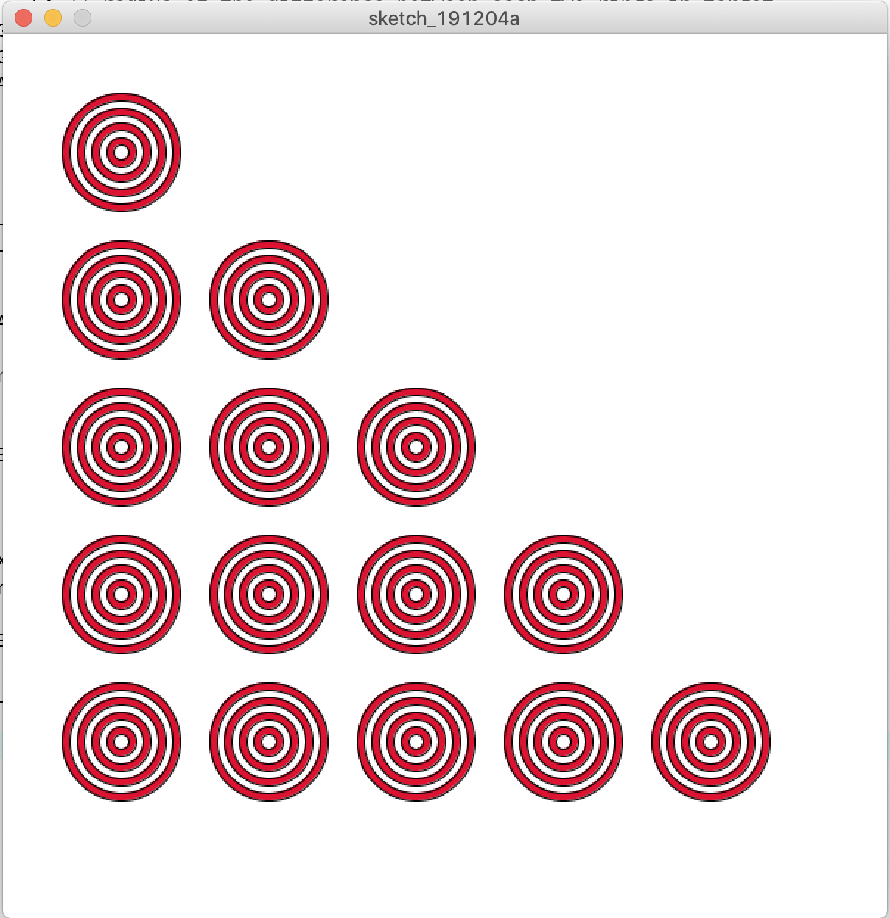
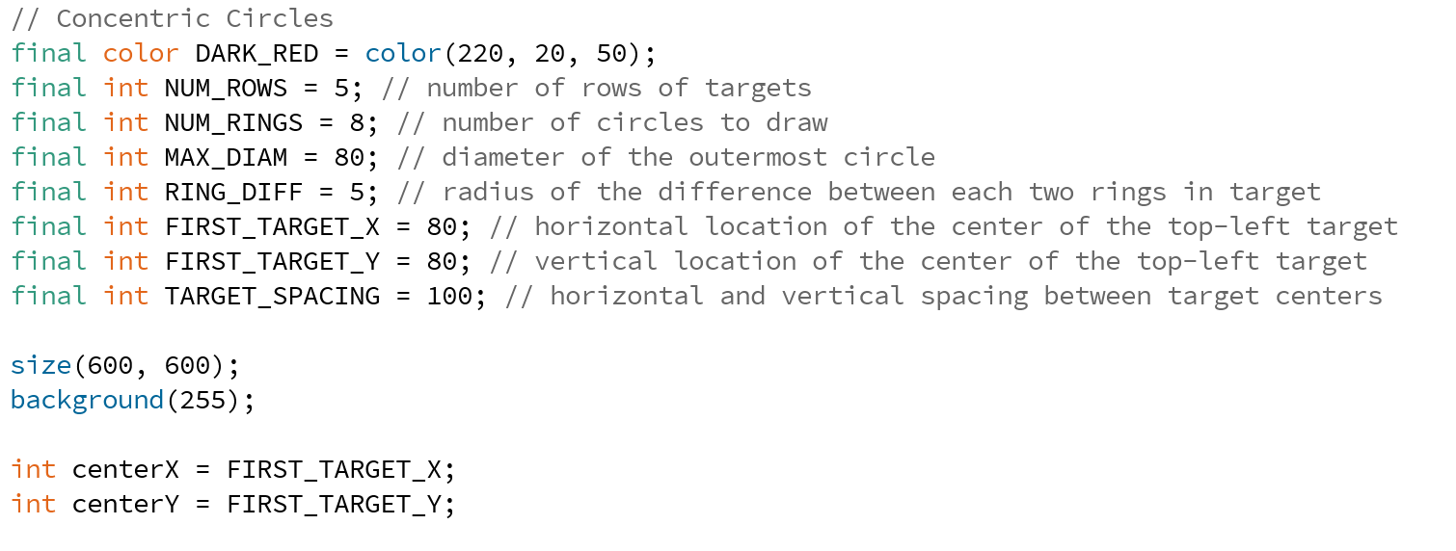
Loops Programming Question
Write a static Processing script (no functions) that draws the image to the right. This consists of targets made by drawing circles on top of other circles, alternating the colours from red to white. Each target consists of 8 concentric circles. The diameter of each circle is 10 pixels smaller than the circle drawn before it. Use the provided constants and variables.
Notes:
Strings, loops, if

Slide 31
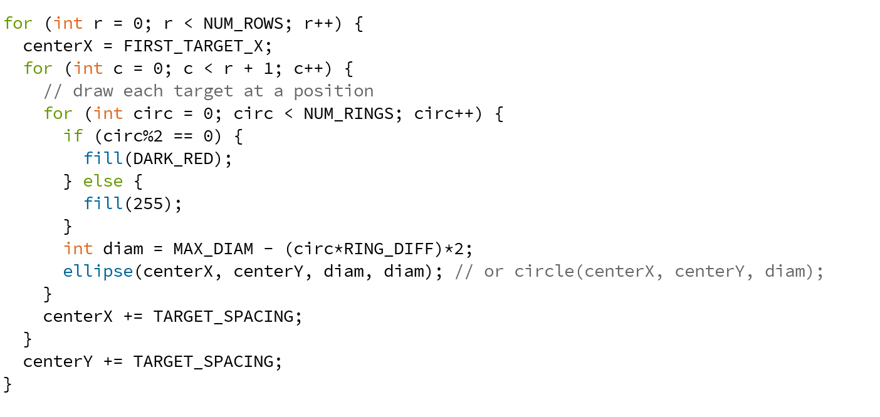
Loops Programming Question
Write a static Processing script (no functions) that draws the image to the right. This consists of targets made by drawing circles on top of other circles, alternating the colours from red to white. Each target consists of 8 concentric circles. The diameter of each circle is 10 pixels smaller than the circle drawn before it. Use the provided constants and variables.
Notes:
Strings, loops, if

Slide 32
Loops Programming Question
0.5 for outer for loop counting through the rows
1.0 for middle for loop that counts up to row#+ 1
0.5 for inner for loop that counts through rings of the circle
1.0 for using circ%2, or alternating boolean var for red/white switch
0.5 adjusting down the diameter inside the inner for loop
0.5 for drawing ellipse or circle
0.5 for incrementing centerX in middle for loop
0.5 for incrementing centerY in outer for loop
Deductions:
- 1 for using same variable name in multiple loops
0.5 for not using provided constants
0.5 for not using centerX, centerY
BRITT
Notes:
Strings, loops, if

Slide 33
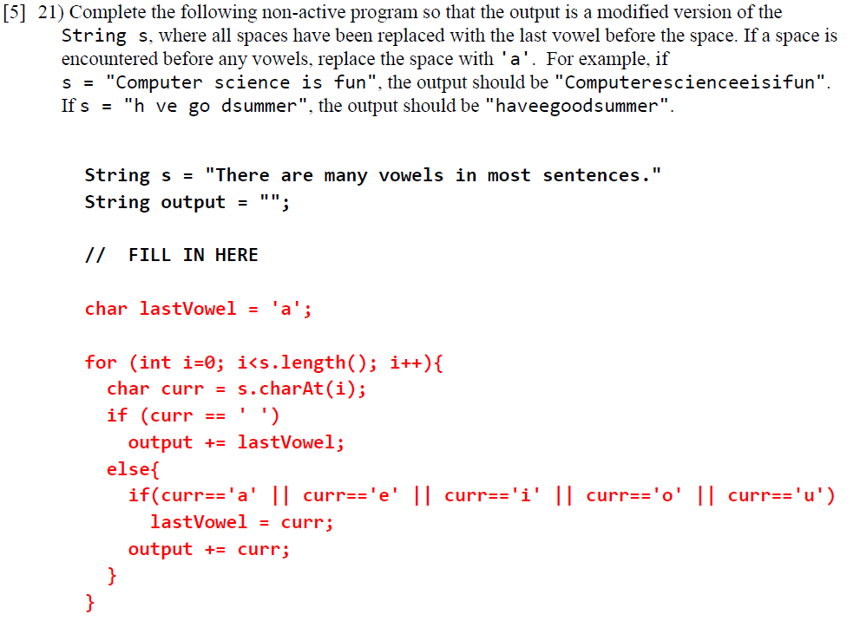
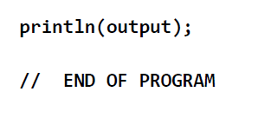
Strings and Chars Programming Question
Notes:
Strings, loops, if

Slide 34
Strings and Chars Programming Question
0.5 for creating a char variable initialized to ’a’
1.0 for a for loop from 0 to s.length()
0.5 for getting and storing each char in a different temp var
1.0 for replacing ‘ ‘ with lastVowel in output
0.5 for testing for the 5 vowels using ||
0.5 for storing each new vowel in lastVowel
1.0 for storing letters in output
Deductions:
- 0.5 for using = instead of == in tests
0.5 using nested loops
0.5 for using two separate if statements instead of if-else
MATTHEW

Slide 35
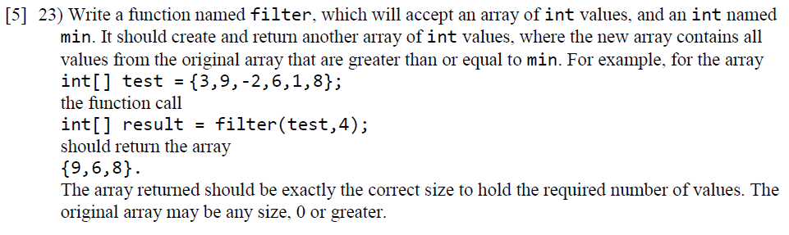
Basic arrays and functions programming question
Notes:
ARRAYS, functions, loops, if

Slide 36
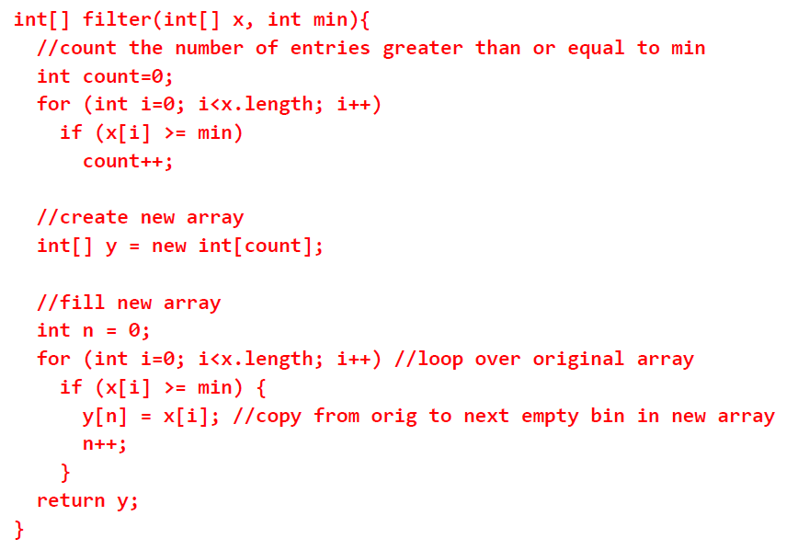
Basic arrays and functions programming question
0.5 for creating int counter
1.0 for looping through and counting items >= min
1.0 for creating new array the correct size
0.5 for creating int counter for new array
1.0 for coping values >= min into new array
0.5 for incrementing int counter
0.5 for returning new array
Deductions:
- 0.5 for doing > instead of >=
0.5 for returning y[] or y[count]
0.5 using nested loops
Note: alternative approach is to create new array same size, do copies, then create smaller copy of new array. That’s fine.
JOHN

Slide 37
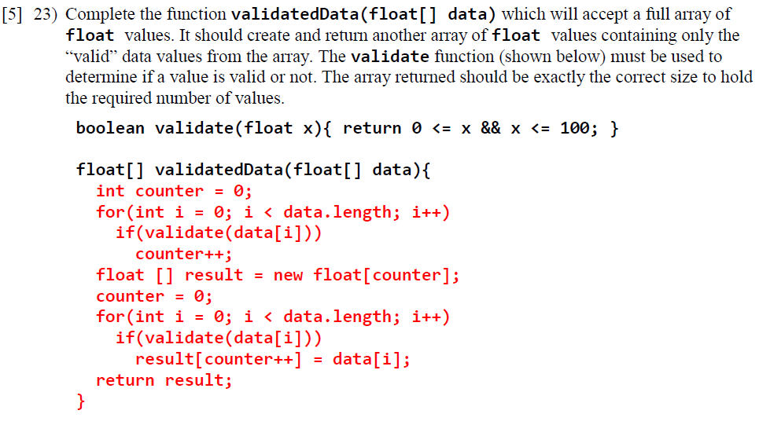
Basic arrays Programming Question
Notes:
arrays

Slide 38
Basic arrays Programming Question
0.5 for creating int counter
1.0 for looping through and counting items that are valid
1.0 for creating new array the correct size
0.5 for creating int counter for new array
1.0 for coping validated values into new array
0.5 for incrementing int counter
0.5 for returning new array
Deductions:
- 0.5 for returning result[] or result[counter]
0.5 using nested loops
Note: alternative approach is to create new array same size, do copies, then create smaller copy of new array. That’s fine.
Also okay to do increment as separate step
JOHN

Slide 39
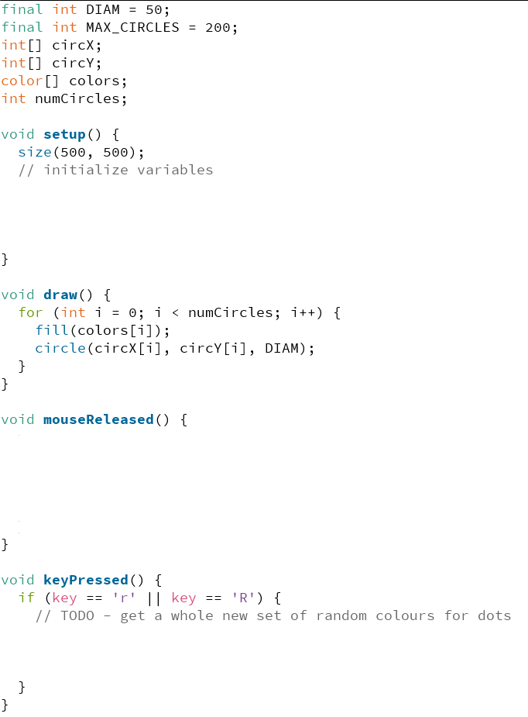
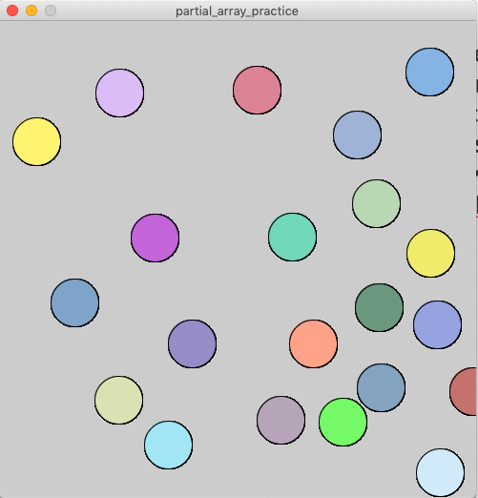
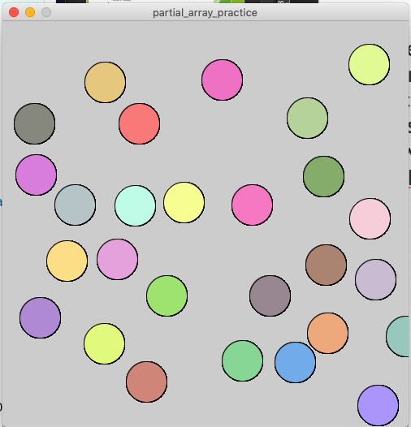
Partial Arrays Practice Question
Complete the following program so that clicking on the canvas adds another dot where the user clicked (if there is room in the arrays to add another dot). Choose a random color for the dot.
When the user presses R or r on the keyboard, the colors array should get reset with all new colors for the dots. Complete setup, mouseReleased and keyPressed.
Use provided arrays, constants & variables
After pressing ‘r’ and clicking a few more times to add more dots:

Slide 40
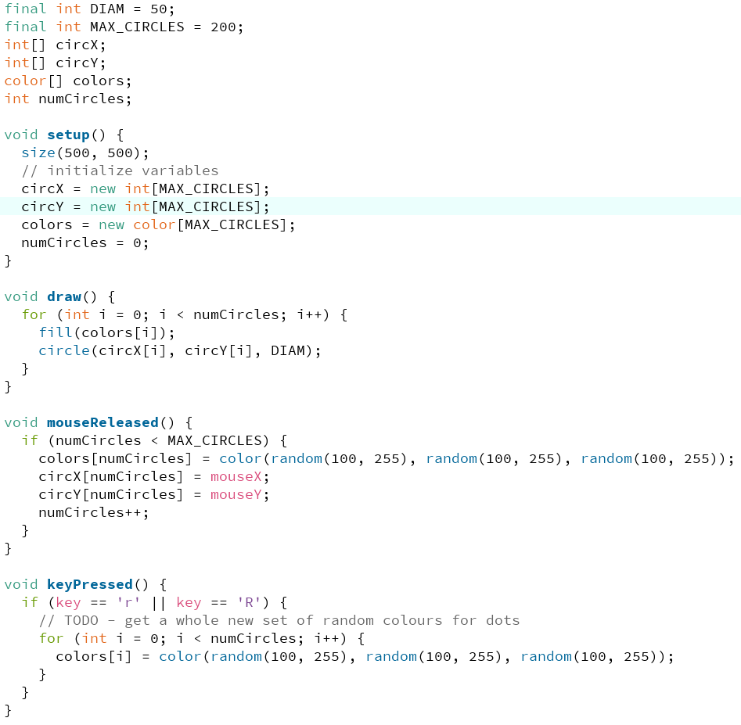
Partial Arrays Practice Question
Complete the following program so that clicking on the canvas adds another dot where the user clicked (if there is room in the arrays to add another dot). Choose a random color for the dot.
When the user presses R or r on the keyboard, the colors array should get reset with all new colors for the dots. Complete setup, mouseReleased and keyPressed.
Use provided arrays, constants & variables
After pressing ‘r’ and clicking a few more times to add more dots:

Slide 41
Partial Arrays Practice Question
Rubric:
1.0 for correct array initialization
0.5 for correct numCircles initialization
0.5 for if statement that tests against MAX_CIRCLES in mouseReleased()
1.0 for updating contents of 3 arrays in mouseReleased
0.5 for incrementing numCircles
1.0 for correct for loop in keyPressed up to numCircles
0.5 for updating color arrays
Deductions:
--0.5 for not using provided constants
BRITT

